Slide 1

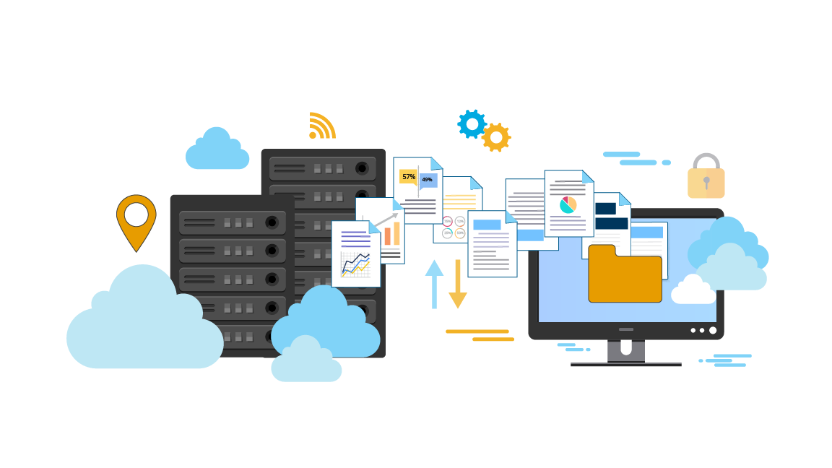
AWS Migration
Notes:
Welcome back to the forth module of data science.

Slide 2
Agenda
01
02
What is Cloud Migration?
Why Migration is important?
03
04
Migration Process in AWS
6 ‘R’s Migration Strategy
05
06
VM Migration
DEMO 1: Local VM Migration
07
08
Database Migration
DEMO 2: Local Database Migration
09
10
More Migration Services
Summary

Slide 3
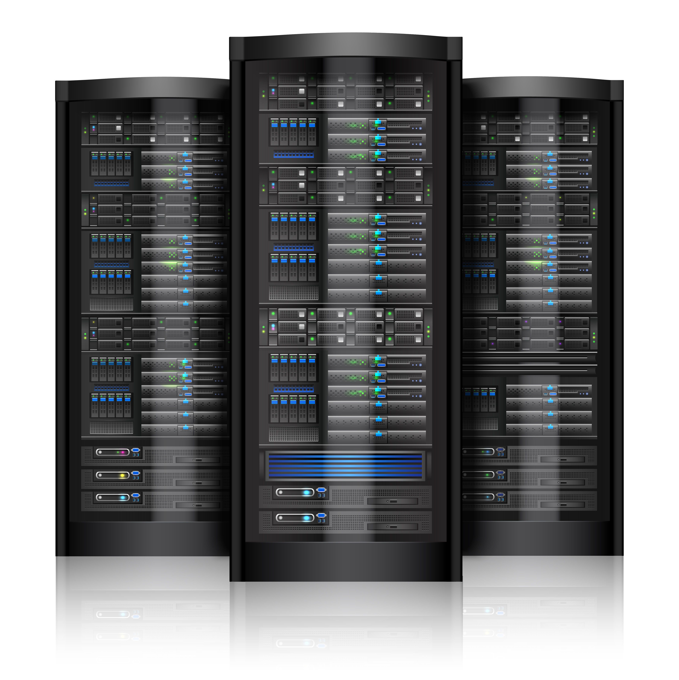

What is Cloud Migration?

Slide 4



What is Cloud Migration?
Cloud Migration is the term for moving data, applications, or any local element like a virtual machine to the Cloud Computing environment

Slide 5

Why Migration is important?

Slide 6



Why Migration is important?
Business owner wants to expand his business, thinking of a plan

Slide 7



Why Migration is important?
The business owner found a solution and wants to move his application to the cloud for reducing cost and a global reach

Slide 8




Why Migration is important?
Now his customers have increase and the profits are increasing every day
Cloud has provided the business better reach and is reducing operational costs which makes it more profitable

Slide 9






Why Migration is important?
Business can have global reach
Better application and data security
Reduce operational costs
Scale according to the application traffic
Faster application implementation
Better disaster recovery strategies

Slide 10
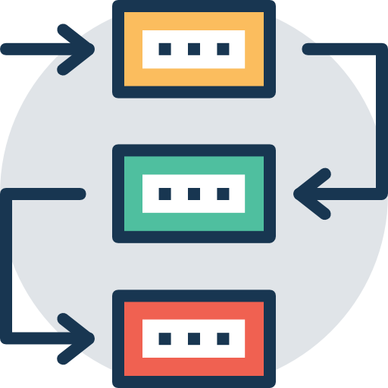
Migration process in AWS

Slide 11





Migration process in AWS
Migration & Validation
Migration Preparation & Business Planning
Portfolio Discovery & Planning
Operate
Application Design

Slide 12

The 6 R’s – Migration Strategies

Slide 13
The 6 R’s – Migration Strategies
01
Rehost
Replatform
02
03
Repurchase
Refactor / Re-architect
04
05
Retire
Retain
06

Slide 14
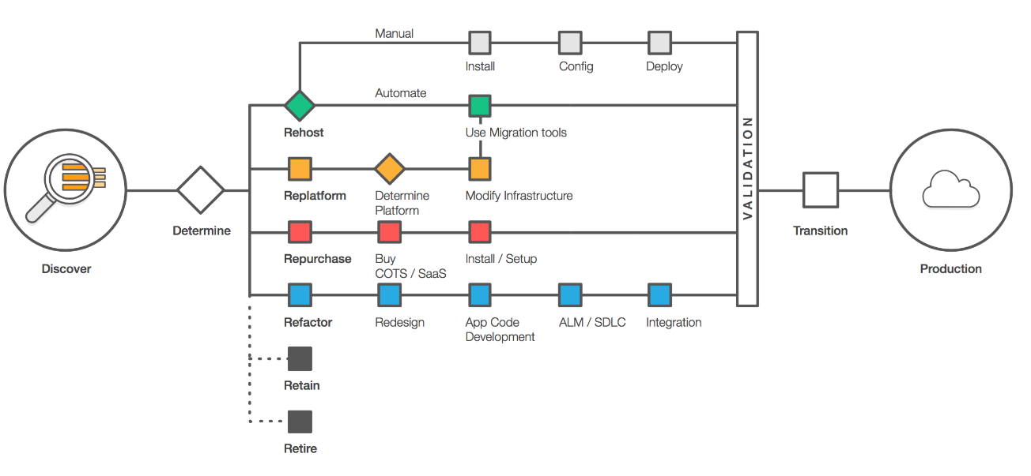
The 6 R’s – Migration Strategies

Slide 15


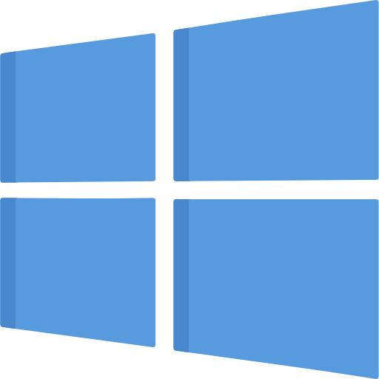

Virtual Machine Migration

Slide 16



Virtual Machine Migration
Migrating your local Virtual Machine to Amazon EC2
Local Virtual Machine
Imported AMI
Multiple EC2 instances launched

Slide 17

Virtual Machine Migration
How to migrate?
Download and Install AWS CLI
Export your local VM as a VMDK file and upload it to a S3 bucket
Import the VM using commands
Monitor your Import task until you see an AMI
Launch Virtual Machines with AMI

Slide 18

DEMO 1:
Local VM Migration

Slide 19


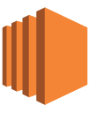

Demo 1: Local VM Migration
Upload VMDK file
Use VMDK file to create AMI
Use AMI to create EC2 instances
Ubuntu Server Local VM
S3 bucket with VMDK file
Created AMI for local VM
EC2 instance launched using AMI

Slide 20

Database Migration

Slide 21
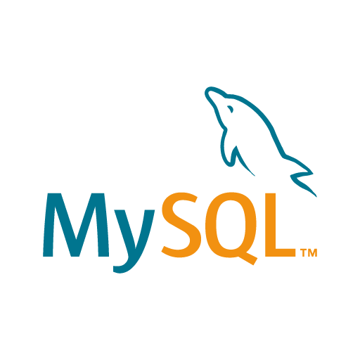
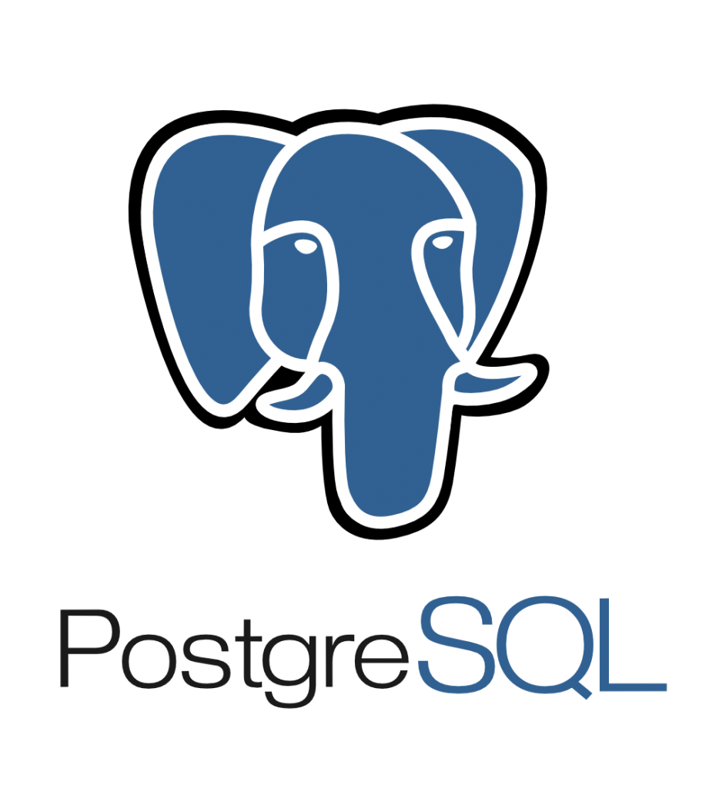

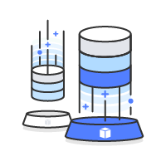


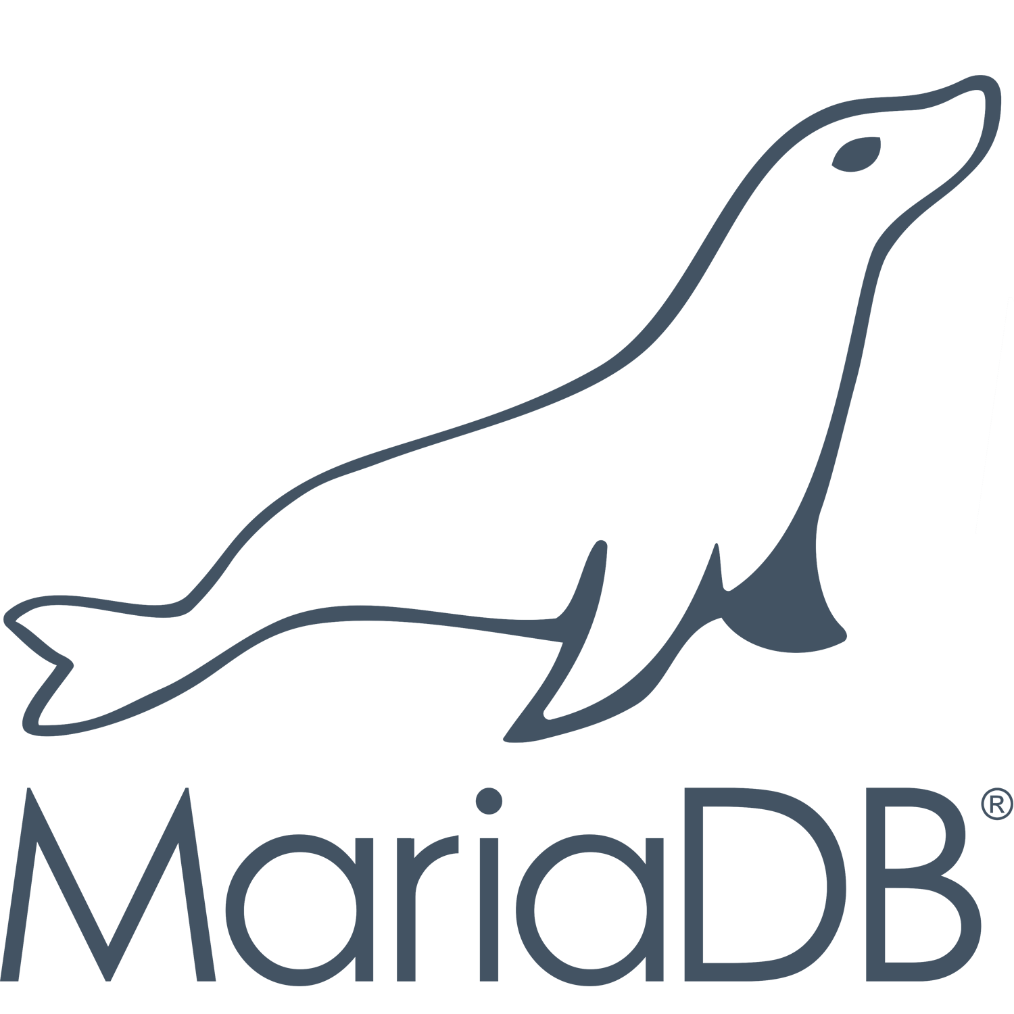

Database Migration
Migrating a local database to RDS or migrating one RDS instance to another RDS instance
On-premise Database
RDS Instance
Migrating to other RDS instances (Different DB Engine)

Slide 22
Database Migration
How to migrate?
Export local Database to a SQL file
Create RDS instance and run the SQL file
Use Database Migration Service to migrate this RDS instance
Create Source RDS and Destination RDS Endpoints
Migrate the database using DMS (Different DB Engine)

Slide 23
DEMO 2:
Database Migration

Slide 24

Demo 2: Database Migration
EC2 MySQL instance
Database Migration Service
Migrated RDS MySQL Database
Source Endpoint
Destination Endpoint

Slide 25
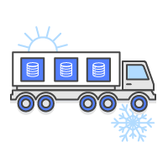

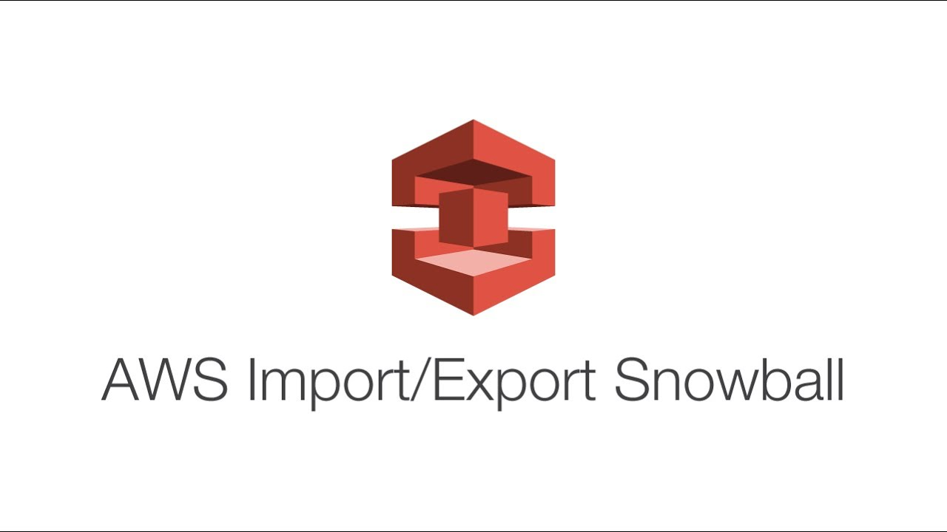

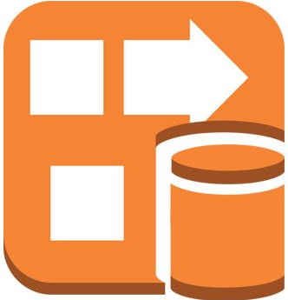

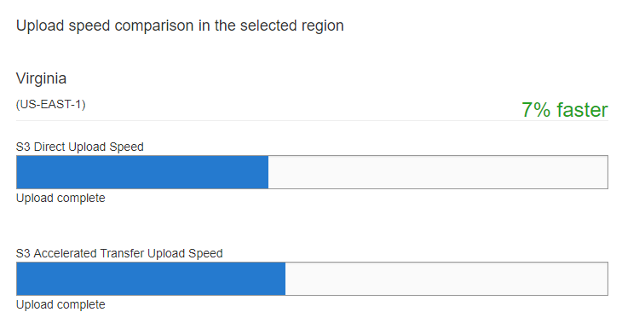
Other AWS Migration Services
Amazon S3 Transfer Acceleration makes the public internet transfers to S3 buckets faster

Slide 26
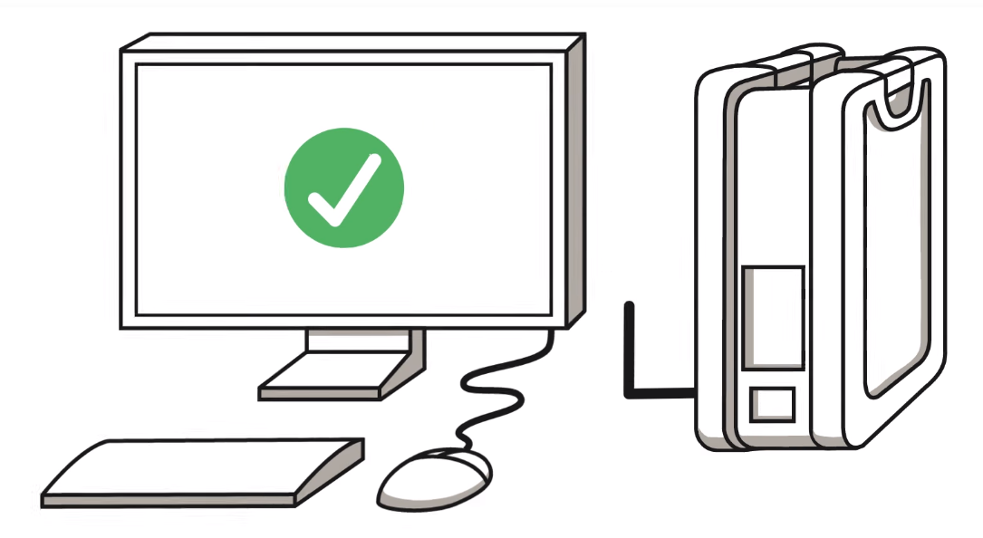
Other AWS Migration Services
AWS Snowball is a secure transfer service for petabytes of data in and out of AWS

Slide 27
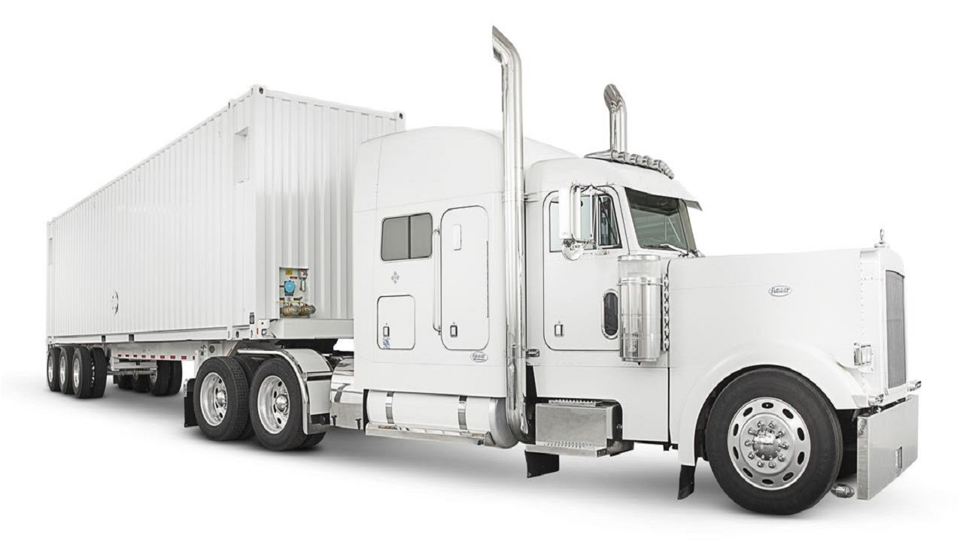



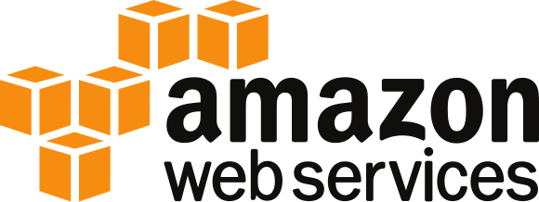
Other AWS Migration Services
AWS Snowmobile is a service for transfer of extremely large amounts of data (exabyte)
45 foot-long container
Connect to database with fibre cable
Fill it with data
Transports data to AWS

Slide 28

Other AWS Migration Services
AWS Direct Connect allows you to create a dedicated network connection between your premises and AWS

Slide 29
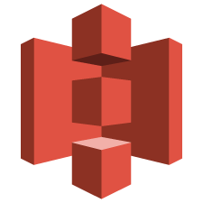


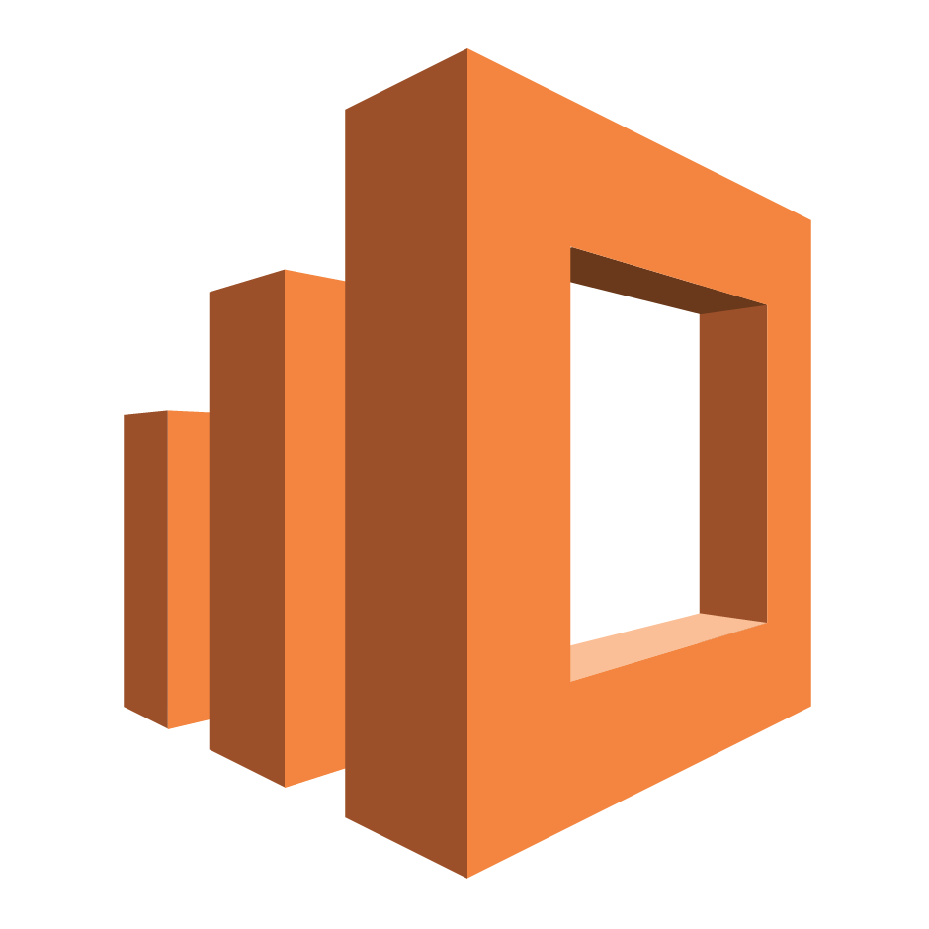
Other AWS Migration Services
Amazon Kinesis Firehose is used to load streaming data into AWS services like S3 or Redshift
S3
Redshift
Elasticsearch
Kinesis Analytics

Slide 30

Summary

Slide 31





Summary
What is Cloud Migration?
The 6 R’s Migration Strategies
Other Migration Services
Why Migration?
VM and DB Migration

Slide 32
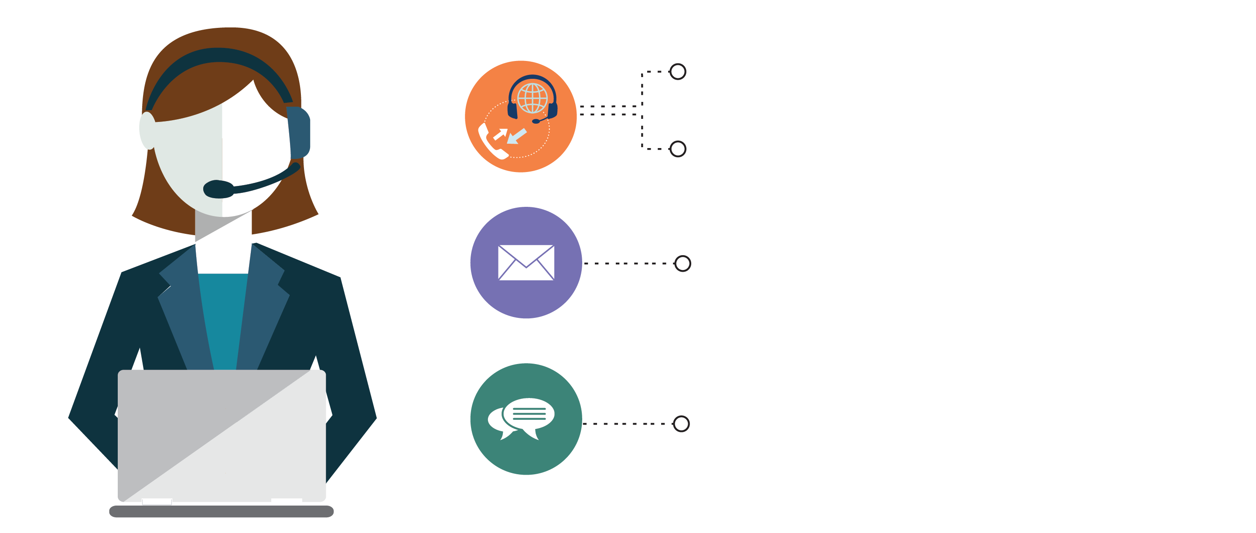
India : +91-7847955955
US : 1-800-216-8930 (TOLL FREE)
sales@intellipaat.com
24X7 Chat with our Course Advisor
Notes:
Thank you!

